Slide 1


Aportamos bases para decisiones rentables

Slide 2
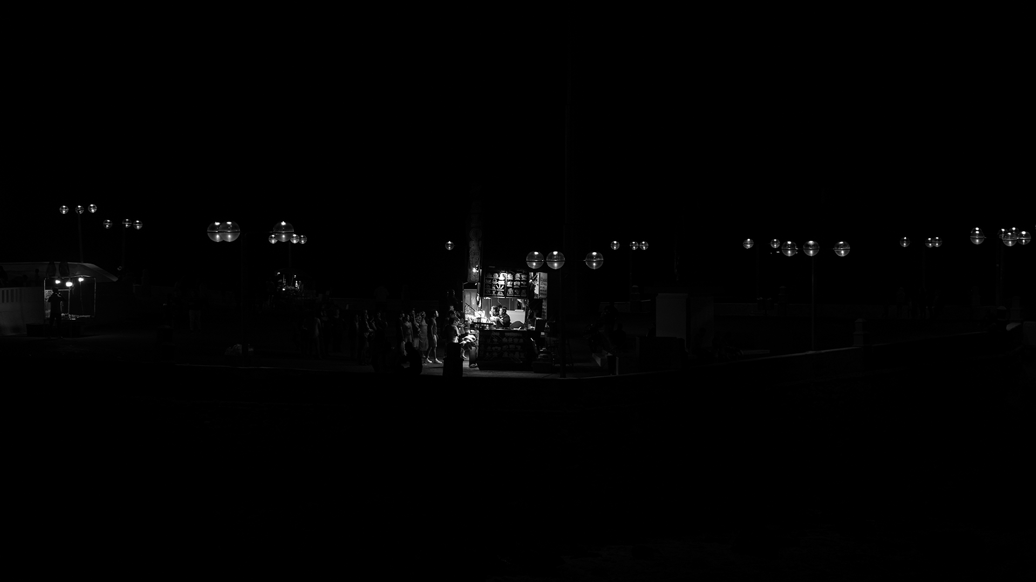

TENDENCIA
PRECIO X M²
Stelarhe

Slide 3
¿Por qué varían las proyecciones de hace un año?
Las proyecciones de precios por metro cuadrado se ajustaron drásticamente debido a:
Aumento en la percepción de riesgo por la inseguridad,
Cambios macroeconómicos adversos
Incertidumbre generada por las tensiones geopolíticas entre EE.UU. y México
Afectando la confianza y dinámica del mercado inmobiliario.
Fuente: Proyecciones realizados por Ideas Frescas.

Slide 4
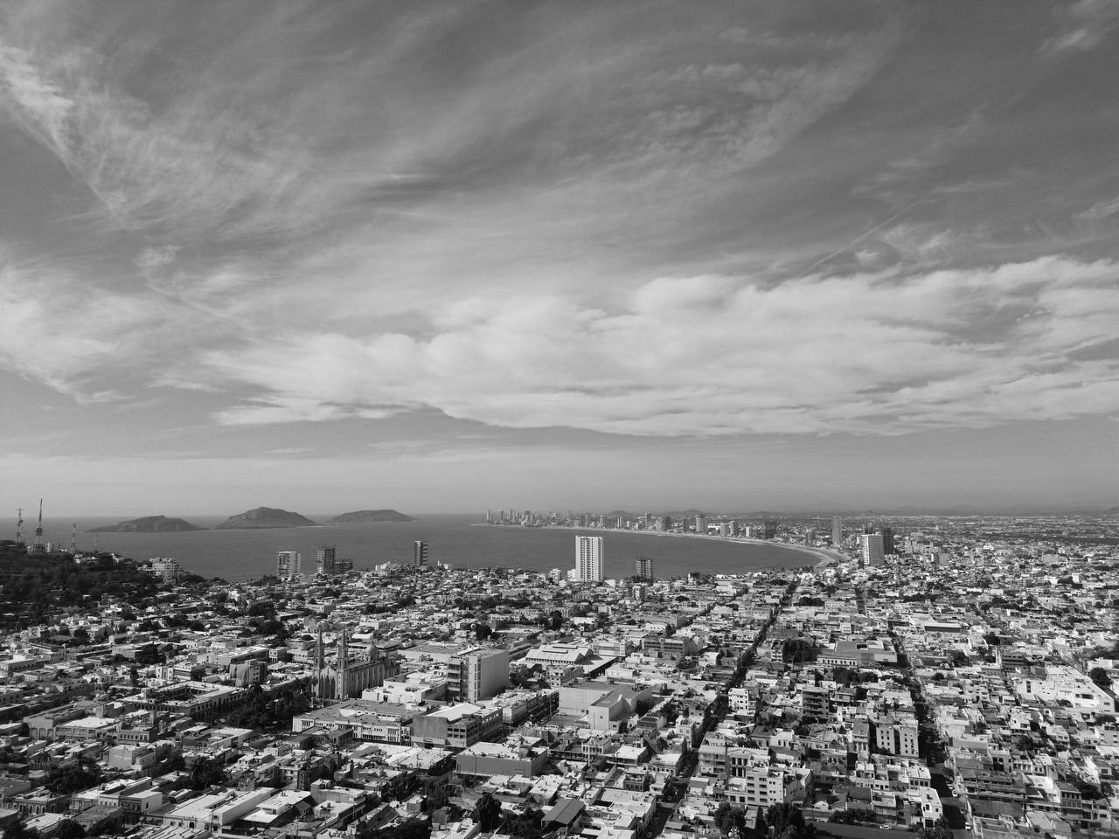
Proyecciones
Stelarhe 2025

Slide 5
INDICADORES MACROECONÓMICOS, FASE ECONÓMICA
Fase Económica | Crecimiento PIB Mazatlán | Inflación | Tasa de Interés | Empleo Sinaloa
Expansión | >3% | >4% | Bajando o estable | Alto
Normal | 1% – 3% | 2% – 4% | Estable | Estable
Recesión | -1% a 1% | 1% – 2% | Subiendo | Bajo
Depresión | < -1% | <=0% | Alto | Muy bajo
Fuente: Datos obtenidos de las paginas del INEGI, Banco de México y Bolsa Mexicana Valores

Slide 6
INCREMENTO POR FASE ECONÓMICA POR ESCENARIO
Fase Económica | Prob. | Escenario NORMAL (cuánto aumenta el precio x m² en este escenario) | Escenario OPTIMISTA (cuánto aumenta el precio x m² en este escenario)
Depresión | 0.01% | -0.5% | 2.0%
Expansión | 0.0% | 7.8% | 15.7%
Normal | 81% | 1.0% | 7.2%
Recesión | 19% | 0.4% | 5.%
Fuente: Datos obtenidos de las paginas del INEGI, Banco de México y Bolsa Mexicana Valores

Slide 7
PROYECCIÓN PRECIO m²
Stelarhe
Stelarhe
optimista
Stelarhe
normal
+ $6.5 M
- $6.4 M
Fuente: Proyecciones realizados por Ideas Frescas. La fase moderada implica un mercado normal con incremento del 1% en los precios por trimestre.

Slide 8
PROYECCIÓN PRECIO FINAL
Stelarhe 149 m²
optimista
Variación
x trimestre
Stelarhe 149 m²
normal
+ $6.5 M
130 m²
- $6.4 M
105 m²
Fuente: Proyecciones realizados por Ideas Frescas.

Slide 9
VENTAS
Del 2021 al 2025
STELARHE
Ventas históricas: Promedio mensual de ventas desde el lanzamiento del proyecto.
+ $6.5 M
- $ 6.4 M
Fuente: Investigación realizada por Ideas Frescas. Información correspondiente a Febrero de 2025.

Slide 10
PROYECCIÓN ABSORPCIÓN
Último mes
- $6.4 M
Proyección de ventas: Ventas esperadas en el último mes del trimestre.
STELARHE
+ $ 6.5 M
Fuente: Proyecciones realizadas por Ideas Frescas.

Slide 11
Demanda de vivienda en MAZATLÁn
Proyección 2025, cantidades basadas en el indicador del último mes, cantidades trimestrales
TOTAL
ÚLTIMO MES
HORIZONTAL
ÚLTIMO MES
VERTICAL
ÚLTIMO MES
Fuente: Datos históricos de estudios previos realizados por Ideas Frescas. Los datos son trimestrales.

Slide 12
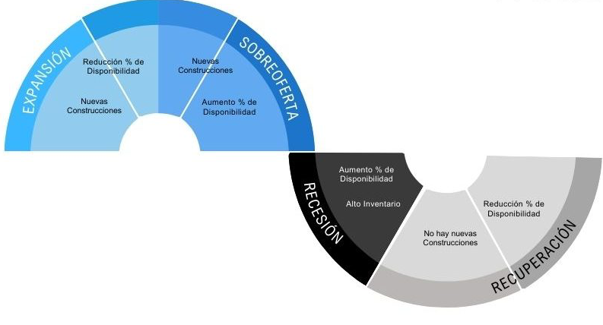
TIENDAS DE CONVENIENCIA
EN ZONA DE ESTUDIO
ciclo económico inmobiliario

Slide 13
TIENDAS DE CONVENIENCIA
EN ZONA DE ESTUDIO
ANEXO

Slide 14
PROYECCIONES DE PRECIOS XMODELOS EN FASE OPTIMISTA
Modelo | Precio Inicial | T1 2025 | T2 2025 | T3 2025 | T4 2025 | T1 2026 | T2 2026 | T3 2026 | T4 2026 | T5 2027 | T6 2027 | T7 2027 | T8 2027
A+1 | $70,439 | $93,166 | $99,511 | $106,298 | $113,509 | $124,843 | $133,339 | $142,402 | $152,077 | $167,314 | $178,613 | $190,667 | $203,547
A1 | $70,383 | $93,115 | $99,415 | $106,163 | $113,360 | $124,694 | $133,133 | $142,185 | $151,781 | $166,954 | $178,266 | $190,288 | $203,179
A2 | $70,346 | $93,059 | $99,398 | $106,146 | $113,319 | $124,643 | $133,124 | $142,217 | $151,885 | $167,109 | $178,380 | $190,576 | $203,512
A3 | $74,365 | $98,357 | $105,065 | $112,160 | $119,774 | $131,737 | $140,652 | $150,196 | $160,383 | $176,386 | $188,373 | $201,168 | $214,876
A4 | $70,177 | $92,765 | $99,063 | $105,746 | $112,934 | $124,209 | $132,650 | $141,692 | $151,378 | $166,532 | $177,874 | $189,960 | $202,839
A5 | $70,326 | $93,003 | $99,311 | $106,021 | $113,206 | $124,525 | $132,974 | $141,906 | $151,587 | $166,730 | $178,079 | $190,181 | $203,104
B2 | $70,597 | $93,404 | $99,732 | $106,522 | $113,734 | $125,130 | $133,623 | $142,721 | $152,365 | $167,652 | $178,995 | $191,173 | $204,135
B3 | $80,248 | $106,169 | $113,378 | $121,066 | $129,254 | $142,153 | $151,822 | $162,119 | $173,169 | $190,424 | $203,385 | $217,106 | $231,786
B4 | $82,310 | $108,841 | $116,181 | $124,088 | $132,513 | $145,716 | $155,551 | $166,065 | $177,328 | $194,953 | $208,198 | $222,331 | $237,405
C1 | $74,120 | $98,040 | $104,660 | $111,763 | $119,362 | $131,267 | $140,165 | $149,665 | $159,824 | $175,756 | $187,704 | $200,449 | $214,080
E | $80,229 | $106,089 | $113,329 | $121,028 | $129,255 | $142,181 | $151,842 | $162,178 | $173,093 | $190,418 | $203,243 | $217,008 | $231,703
F | $70,915 | $93,769 | $100,135 | $106,949 | $114,167 | $125,575 | $134,083 | $143,200 | $152,919 | $168,249 | $179,641 | $191,800 | $204,741
G | $73,133 | $96,761 | $103,343 | $110,346 | $117,831 | $129,566 | $138,387 | $147,785 | $157,805 | $173,557 | $185,315 | $197,879 | $211,287
H | $71,235 | $94,201 | $100,625 | $107,438 | $114,748 | $126,193 | $134,765 | $143,906 | $153,737 | $169,025 | $180,481 | $192,783 | $205,901
I | $72,855 | $96,353 | $102,896 | $109,856 | $117,354 | $129,069 | $137,791 | $147,160 | $157,151 | $172,881 | $184,584 | $197,123 | $210,460
J | $70,504 | $93,235 | $99,554 | $106,307 | $113,549 | $124,851 | $133,320 | $142,365 | $152,017 | $167,157 | $178,524 | $190,586 | $203,547
Jr.1 | $89,636 | $118,528 | $126,516 | $135,041 | $144,210 | $158,597 | $169,377 | $180,891 | $193,167 | $212,474 | $226,882 | $242,349 | $258,793
Jr.2 | $93,021 | $123,038 | $131,403 | $140,367 | $149,869 | $164,741 | $175,979 | $187,939 | $200,716 | $220,868 | $235,804 | $251,861 | $269,044
K1 | $70,909 | $93,776 | $100,163 | $106,925 | $114,200 | $125,623 | $134,167 | $143,270 | $152,957 | $168,223 | $179,725 | $191,869 | $204,824
K2 | $74,327 | $98,297 | $104,975 | $112,111 | $119,722 | $131,667 | $140,598 | $150,129 | $160,299 | $176,312 | $188,257 | $200,975 | $214,595
K3 | $74,312 | $98,301 | $104,989 | $112,114 | $119,737 | $131,703 | $140,615 | $150,154 | $160,367 | $176,320 | $188,286 | $201,177 | $214,846
M.1 | $88,701 | $117,341 | $125,343 | $133,890 | $142,949 | $157,227 | $167,822 | $179,247 | $191,452 | $210,637 | $224,974 | $240,257 | $256,519
M.2 | $96,931 | $128,199 | $136,906 | $146,189 | $156,105 | $171,689 | $183,346 | $195,808 | $209,066 | $230,041 | $245,621 | $262,313 | $280,124
Fuente: Proyecciones realizadas por Ideas Frescas.

Slide 15
PROYECCIONES DE PRECIOS XMODELOS EN FASE NORMAL
Modelo | Precio Inicial | T1 2025 | T2 2025 | T3 2025 | T4 2025 | T1 2026 | T2 2026 | T3 2026 | T4 2026 | T5 2027 | T6 2027 | T7 2027 | T8 2027
A+1 | $70,439 | $71,054 | $71,681 | $72,314 | $72,945 | $73,582 | $74,229 | $74,880 | $75,536 | $76,204 | $76,863 | $77,529 | $78,201
A1 | $70,383 | $71,002 | $71,619 | $72,245 | $72,876 | $73,513 | $74,153 | $74,804 | $75,449 | $76,108 | $76,772 | $77,433 | $78,106
A2 | $70,346 | $70,962 | $71,588 | $72,213 | $72,841 | $73,476 | $74,122 | $74,778 | $75,435 | $76,101 | $76,761 | $77,443 | $78,120
A3 | $74,365 | $75,014 | $75,677 | $76,332 | $76,999 | $77,671 | $78,347 | $79,034 | $79,723 | $80,416 | $81,122 | $81,833 | $82,553
A4 | $70,177 | $70,778 | $71,399 | $72,015 | $72,647 | $73,280 | $73,922 | $74,574 | $75,234 | $75,895 | $76,564 | $77,234 | $77,905
A5 | $70,326 | $70,937 | $71,556 | $72,176 | $72,805 | $73,442 | $74,086 | $74,720 | $75,382 | $76,040 | $76,711 | $77,385 | $78,062
B2 | $70,597 | $71,219 | $71,841 | $72,473 | $73,103 | $73,748 | $74,394 | $75,048 | $75,698 | $76,368 | $77,031 | $77,710 | $78,386
B3 | $80,248 | $80,954 | $81,662 | $82,377 | $83,093 | $83,818 | $84,555 | $85,295 | $86,049 | $86,795 | $87,558 | $88,315 | $89,080
B4 | $82,310 | $83,022 | $83,741 | $84,478 | $85,219 | $85,957 | $86,702 | $87,454 | $88,217 | $88,977 | $89,757 | $90,542 | $91,332
C1 | $74,120 | $74,769 | $75,416 | $76,076 | $76,743 | $77,410 | $78,086 | $78,767 | $79,454 | $80,144 | $80,847 | $81,556 | $82,270
E | $80,229 | $80,922 | $81,637 | $82,352 | $83,074 | $83,805 | $84,539 | $85,281 | $86,014 | $86,769 | $87,515 | $88,277 | $89,043
F | $70,915 | $71,528 | $72,154 | $72,788 | $73,418 | $74,059 | $74,706 | $75,364 | $76,022 | $76,694 | $77,363 | $78,035 | $78,710
G | $73,133 | $73,778 | $74,426 | $75,075 | $75,731 | $76,386 | $77,059 | $77,734 | $78,412 | $79,096 | $79,786 | $80,482 | $81,182
H | $71,235 | $71,853 | $72,488 | $73,119 | $73,762 | $74,405 | $75,057 | $75,712 | $76,384 | $77,044 | $77,717 | $78,404 | $79,094
I | $72,855 | $73,488 | $74,132 | $74,776 | $75,438 | $76,096 | $76,755 | $77,430 | $78,107 | $78,794 | $79,479 | $80,176 | $80,872
J | $70,504 | $71,117 | $71,737 | $72,363 | $73,000 | $73,631 | $74,275 | $74,924 | $75,577 | $76,231 | $76,901 | $77,568 | $78,248
Jr.1 | $89,636 | $90,415 | $91,197 | $91,982 | $92,788 | $93,596 | $94,418 | $95,247 | $96,081 | $96,921 | $97,767 | $98,629 | $99,491
Jr.2 | $93,021 | $93,833 | $94,656 | $95,493 | $96,323 | $97,149 | $98,008 | $98,867 | $99,732 | $100,616 | $101,490 | $102,382 | $103,284
K1 | $70,909 | $71,525 | $72,154 | $72,777 | $73,417 | $74,060 | $74,710 | $75,363 | $76,017 | $76,680 | $77,362 | $78,034 | $78,710
K2 | $74,327 | $74,973 | $75,631 | $76,294 | $76,962 | $77,632 | $78,309 | $78,992 | $79,680 | $80,375 | $81,077 | $81,781 | $82,493
K3 | $74,312 | $74,965 | $75,622 | $76,283 | $76,952 | $77,627 | $78,302 | $78,986 | $79,680 | $80,368 | $81,071 | $81,794 | $82,509
M.1 | $88,701 | $89,480 | $90,269 | $91,066 | $91,856 | $92,658 | $93,457 | $94,282 | $95,111 | $95,950 | $96,795 | $97,642 | $98,491
M.2 | $96,931 | $97,776 | $98,631 | $99,492 | $100,359 | $101,236 | $102,123 | $103,018 | $103,915 | $104,834 | $105,749 | $106,678 | $107,611
Fuente: Proyecciones realizadas por Ideas Frescas.

